Slide 1


SSHS
CC AI
Course Selection
&
Graduation Requirements
Notes:
NEW Voiceover

Slide 2
Todays Agenda – March 19th
Explain Graduation Requirements for ALL students
Access Grad Planner
Academic History report inputted in your duotang (for anyone absent last CC AI)
*Teachers: please let us know if any students are missing a folder and share a list of those unable to access PowerSchool.
Notes:
Discuss the clusters and requirements that all students need for Graduation

Slide 3
Reminder
ch= credit hours
One semester course = 4 credit hours
All students require 100 total credit hours to graduate

Slide 4
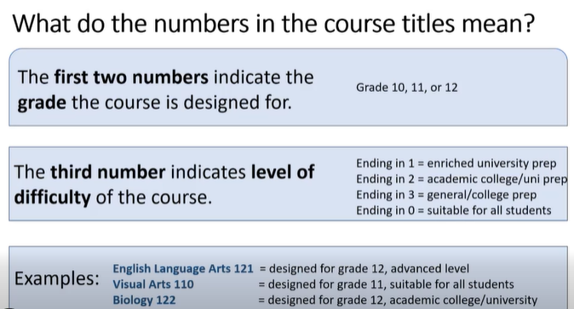

Slide 5

Online Courses
Note: Courses marked with an asterisk * are only available as online courses. To be a successful online student you must have a superior work ethic and time management skills.

Slide 6
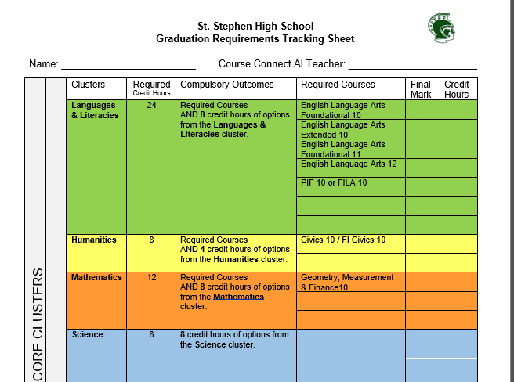
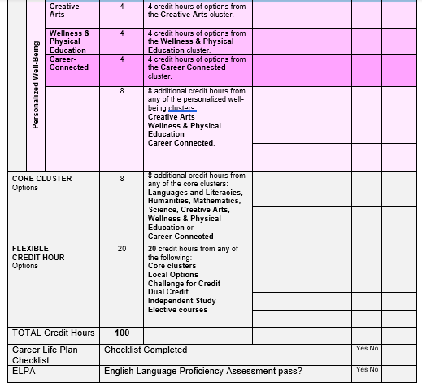
What courses will you need to graduate?
Refer to the Graduation Requirements Tracking Sheet.
Notes:
New voiceover

Slide 7
Languages & Literacies
Graduation Requirements:
24 Language and Literacies credit-hours
Successful completion of the English Language Proficiency Assessment (ELPA).
Required Course(s):
English Language Arts Foundational 10 and Extended 10
English Language Arts Foundational 11
English Language Arts 12
PIF 10 is required for non-immersion students
FILA 10 is required for immersion students
Notes:
NEW VOICEover

Slide 8
Languages & Literacies
Note:
English Language Arts Foundational & Extended 10, are requirements for grade 10 students. (Started Fall 2025)
English is leveled in grades 11 & 12. Level 1, 2, & 3.
Levels 1 & 2 are the English courses for students planning on going to University. Level 3 is the Community College pathway.
English Language Arts EXTENDED 11 is highly recommended for University prep students.
Notes:
ReDo, explain that ELA 10 Foundational and Extended are mandatory, Eng 11 ext is highly recommended for Uni

Slide 9
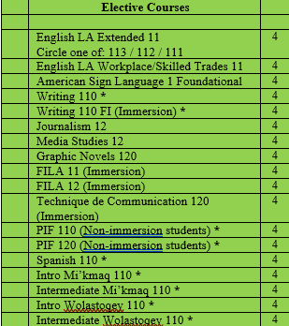
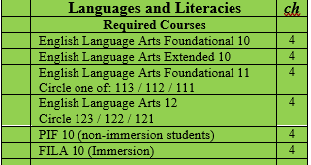
Languages & Literacies

Slide 10
Humanities
Graduation Requirements:
8 Humanities credit-hours
Required Course(s):
Civics or FI Civics
plus 4 credit-hours from one of the designated history courses

Slide 11
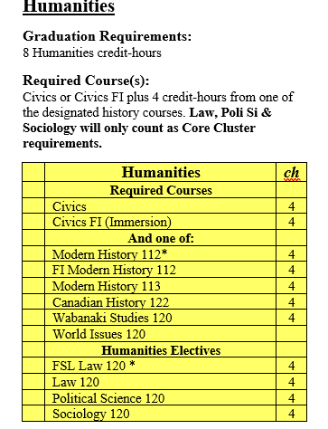
Humanities

Slide 12
Mathematics
Graduation Requirements:
12 Mathematics credit-hours
Required Course(s):
Geometry, Measurement & Finance 10 plus 8 credit-hours from elective courses.
Note:
NRF 10 is highly recommended for Chemistry or Physics.
Foundations of Mathematics 110 is highly recommended for Foundations of Mathematics 120 and for all Calculus pathway courses.

Slide 13
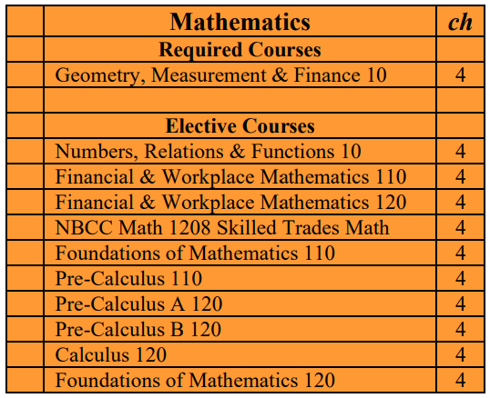
Mathematics

Slide 14
Science
Graduation Requirements:
8 Science credit-hours
Required Course(s):
Any 8 credit-hours from the Science list.
Note:
Science for Sustainable Societies 10 is strongly recommended for Chemistry 112, Physics 112 and Biology 122.
Chemistry 112 is highly recommended for Chemistry 122 and Physics 112 is highly recommended for Physics 122.

Slide 15
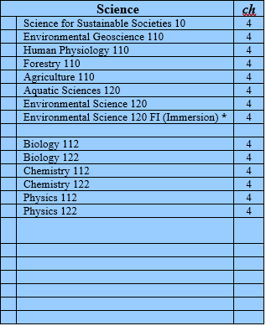
Science
Notes:
Redo voiceover

Slide 16

Personalized
Well-Being
Creative Arts
Wellness and Physical Education
Career- Connected

Slide 17
Personalized Well-Being
Graduation Requirements:
4 Creative Arts credit-hours
4 Wellness and Physical Education credit-hours
4 Career-Connected credit-hours
8 Additional credit-hours from any of the three Personalized Well-Being Clusters
Note:
French Immersion students will choose ONE of Physical Education 10 FI or Career Pathway Design 10 FI.
Personal Interest Courses can be used for any of the three Personalized Well-Being Clusters.

Slide 18
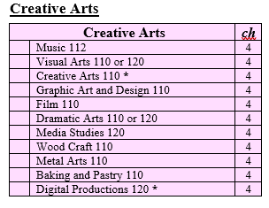
Creative Arts
Notes:
Here are the course options for Creative Arts ** REDO

Slide 19
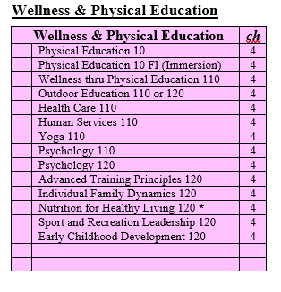
Wellness and Physical Education

Slide 20
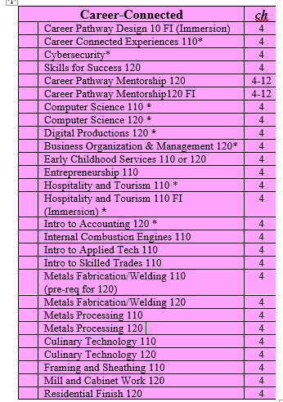
Career-Connected

Slide 21

Personal Interest Courses
Personal Interest Course (1 and 2) offer two elective opportunities for students to pursue individual interests or passions. This is done with a teacher providing supervision and/or oversight.
Notes:
Personal interest course are developed by students and need to be approved before a new semester begins, this means if you are thinking about this now it would be wise to start looking for a teacher supervisor and have conversations in guidance in order for this to be approved before September of next school year.

Slide 22
For French Immersion Students
French Immersion Note:
Students need to acquire 40 credit-hours in French Immersion if they want to receive a French Concentration on their transcript. This will mean students need to take a total of 10 French courses between grades 10-12.
FILA 10, FI Civics 10, FI Phys. Ed 10 or FI Career Pathways 10, FILA 11, FI Mod Hist 110, FI World120 Issues, FILA 12, Tech de Comm 120. Plus, two additional courses online and or FSL Career Mentorship Pathway 120 (Co-op).
In order to qualify for the OPI (oral proficiency interview). You must have at least one French Immersion course at the grade 12 level. – This will be either your FILA 12 and /or Tech de Communication 120.

Slide 23
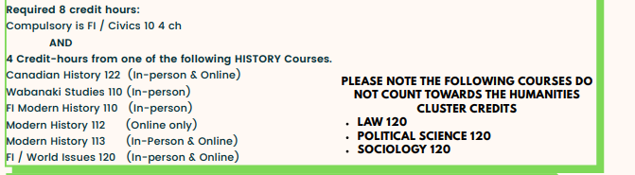
Humanities Reminder
Change Effective Sept. 2024*

Slide 24
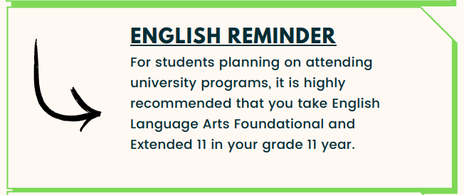
English Language Arts Reminder

Slide 25
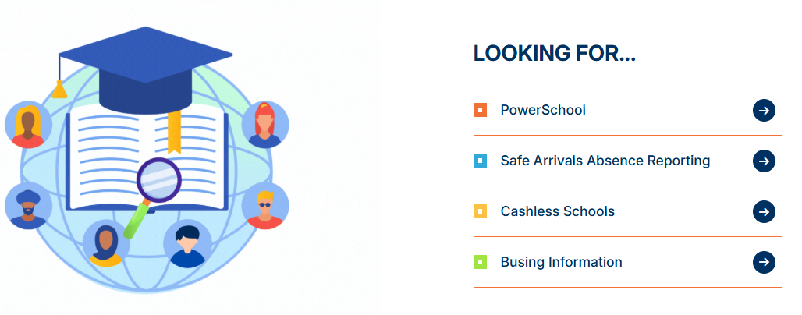
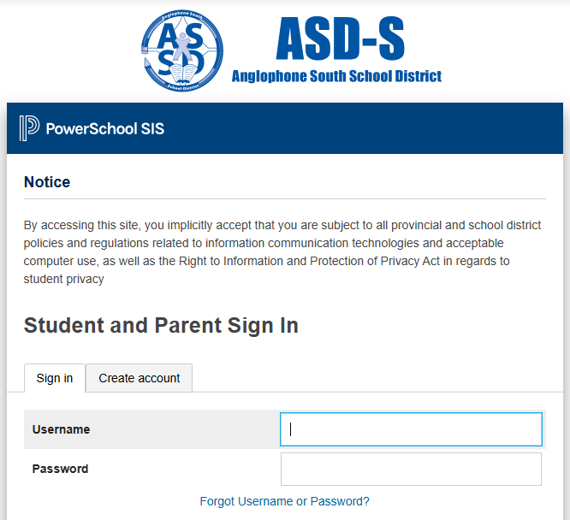
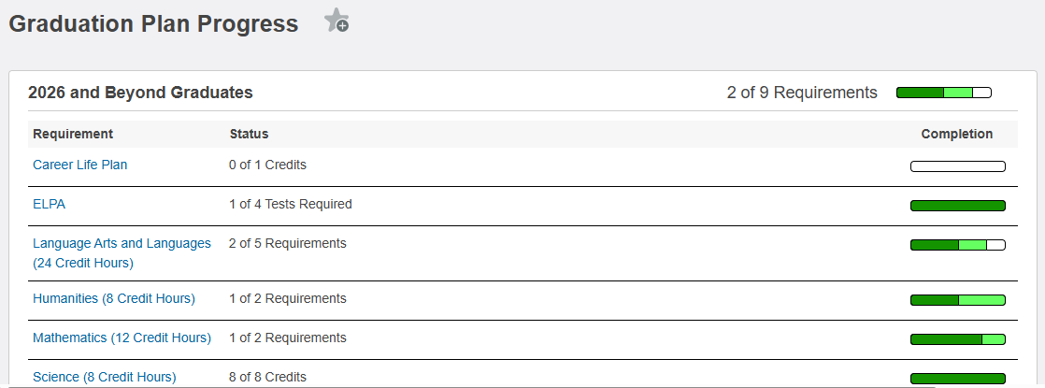
REMINDER Website access to PowerSchool
Teachers, could you circulate to ensure everyone can access their own Grad Planner
Open a new browser on your learning device and access the new school website https://ststephenhigh.nbed.ca/ (or google St. Stephen High School)
Scroll down the page until you see
Ensure that you can log in to Power School & can access your Grad Planner. *Web Browser Only*
Not on App
CLICK HERE
Notes:
AW

Slide 26
Discussion Questions
For those Grade 11/12 students on a nursing pathway, what courses did you take?
If you are interested in a Skilled Trade (like welding, plumbing, carpentry), what courses fit that pathway?
If someone wants to teach High School history what pathway/courses would support that?
How do you find out the requirements for a specific university program?
Please feel free to share your own personal experiences outside of the questions addressed on this slide.
Check out the next slide ->

Slide 27
Discussion Questions – possible answers
For most Nursing programs you need Eng 122 (min. grade of 70%), pre-calc 110 or Foundations 120 (min. grade of 70%), Biology 12 (min. grade of 70%), Chem 12 (min. grade of 70%), and two electives. Overall minimum admission average of 75%.
For admission to most skilled trades programs, you simply need a High School or Adult Diploma. It is highly recommended that you take all skilled trades courses that we offer as well as NBCC workready math. Entrepreneurship is a great option too if you are considering having your own business.
To be a History teacher you would first need a Bachelor of Arts and then you would apply to Education programs in your last year of University. For most BA programs you need English 122 (min. grade of 60%) as well as specific electives recognized by your post-secondary choice. You would consider a major in History within your second year of University.
Check out their website!! For example, google: UNB Admission Requirements Bachelor of Science, Arts, Nursing, etc.
Please feel free to share your own personal experiences outside of what is addressed on this slide.

